Slide 1


MLR Models: Estimation & Inference
Comparison of SLR and MLR Estimation & Inference
… What’s New?... Not Much!
SLR & MLR Standard Errors: Not so different after all!
… An Example

Slide 2
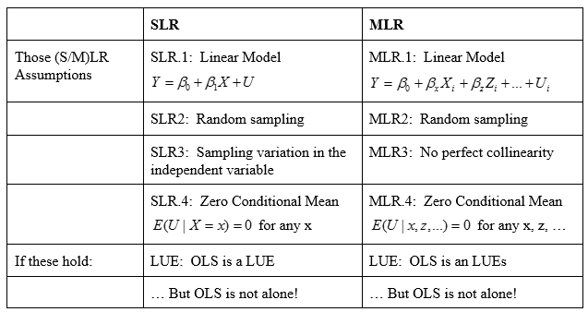

SLR/MLR Compare: Estimation & Inference I

Slide 3
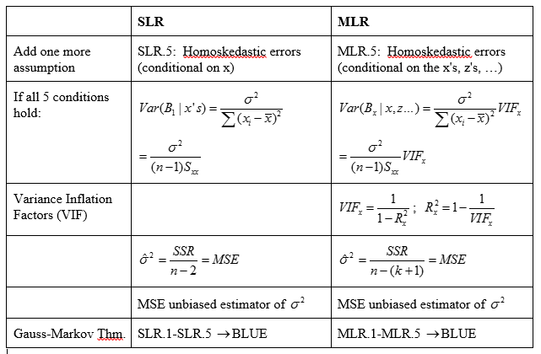
SLR/MLR Compare: Estimation & Inference II

Slide 4
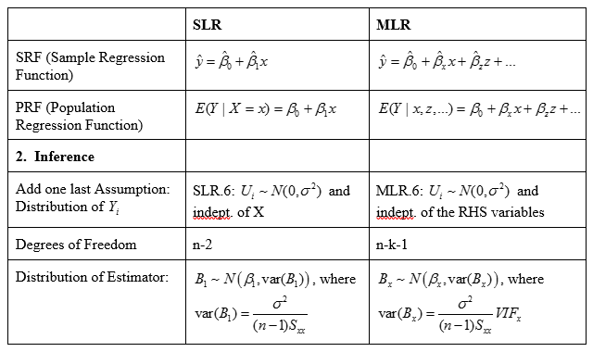
SLR/MLR Compare: Estimation & Inference III

Slide 5
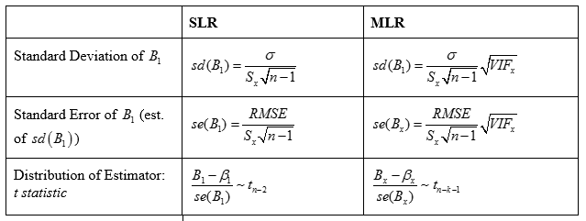
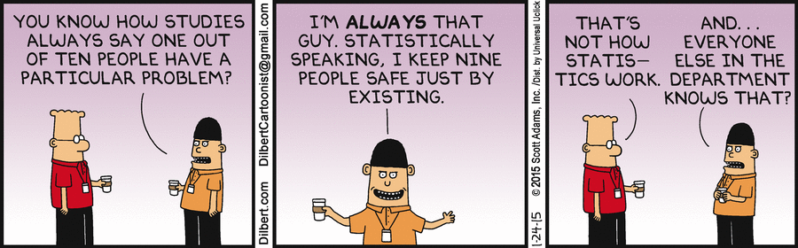
SLR/MLR Compare: Estimation & Inference IV

Slide 6
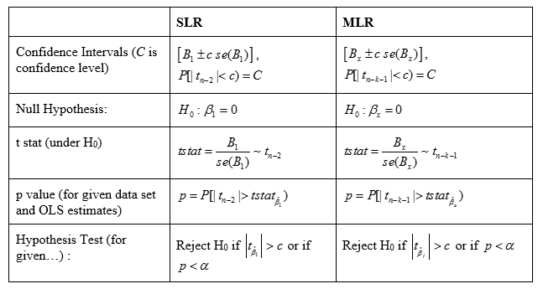
SLR/MLR Compare: Estimation & Inference V

Slide 7
SLR & MLR Standard Errors: Not so different after all!

Slide 8
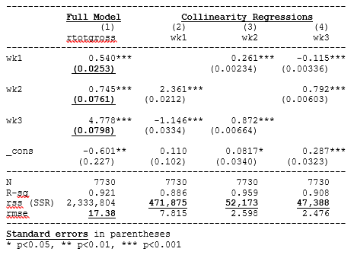

MLR Standard Errors: An Example

